Slide 1


The Relationship between Student Success and Alcohol Consumption
Project Group 3: Ryan Permenter, Hoa Roach, Kelsey Gibson, Abby Herrup and Clarence Robinson
Notes:
Clarence

Slide 2
Overview
Overview of the Data Set
Inspiration
Methods used to Explore the Data
Research Questions
Our Analysis
Our conclusion(s)
Possible Limitations or Biases
Future Work Recommendations
Notes:
clarence

Slide 3
Data Set Overview
Data set used was sourced from Kaggle, but was originally obtained through a survey of students in math class
All students involved in the survey went to either Gabriel Pereira or Mousinho sa Silveira (secondary schools)
Information provided:
Student’s information (school, sex, family size, urban/rural address, guardian, etc..)
Student and Student’s Family Education information (education level, parents education and their current jobs, parents support in education, if the students what to achieve higher education, amount of absences, etc.)
Students grades
Students alcohol consumption for both weekdays and weekends (1-5 scale, from low to very high)
Students extracurricular activities ( amount of free time, if they go out, etc.)
Notes:
clarence

Slide 4
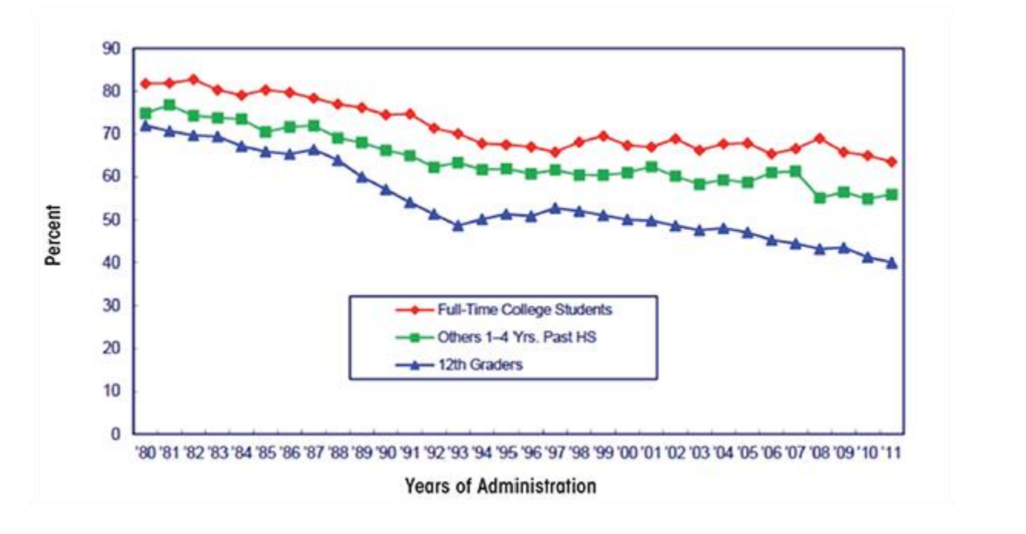
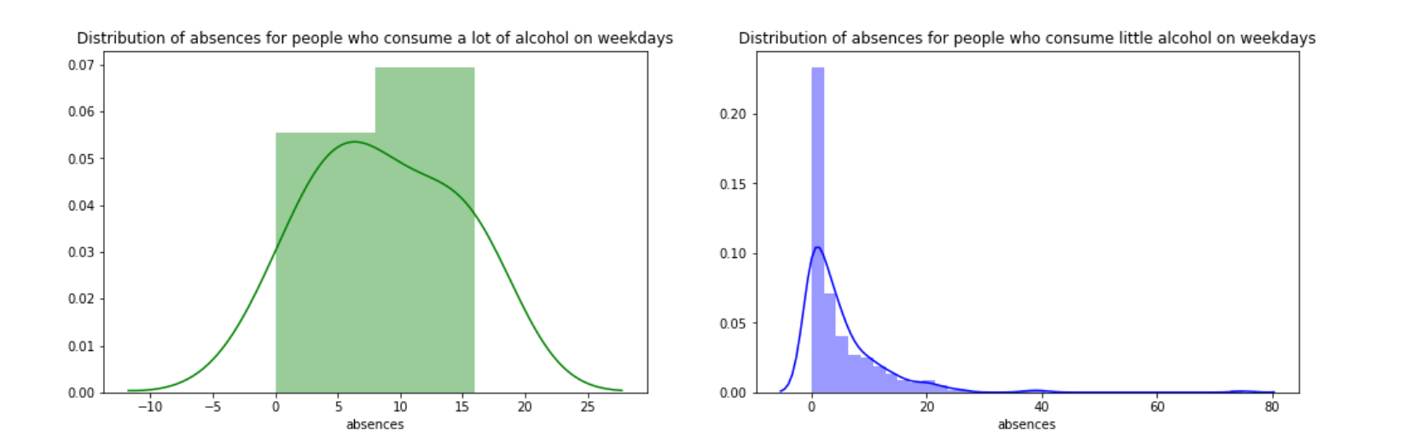
Inspiration
We were inspired by other exploratory data analyses that we found on the topic of student alcohol consumption
Notes:
Kelsey

Slide 5
Method used to complete the analysis- Exploratory Data Analysis (EDA)
Found an existing data set
Identified what we wanted to learn from our data
Cleaned our data
Used Python to create data visualizations
Used Python to complete statistical analyzes
Analyzed our research and came to our conclusions
Notes:
kelsey

Slide 6
Our research questions
Are student’s educational successes predictable based on parent’s education?
Does alcohol consumption differ based on the student’s grades or gender?
Are student grades predictive based on the amount of alcohol they consume?
Is there correlation between demographics, grades or extracurriculars and alcohol consumption?
Does alcohol consumption have an effect on the number of absences students have?
Does alcohol consumption differ based upon student support or amount they study?
Does travel time or study time have an impact on the student’s grade?
Notes:
Ryan

Slide 7
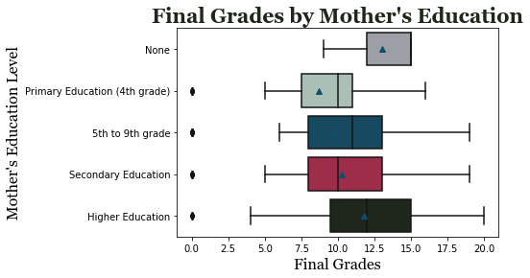
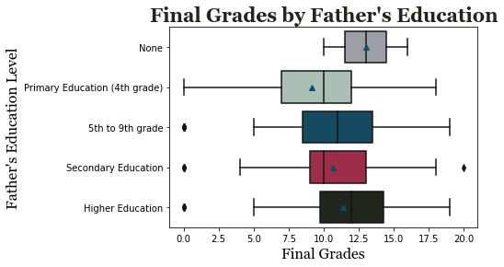
Student Success and parent’s education

Slide 8
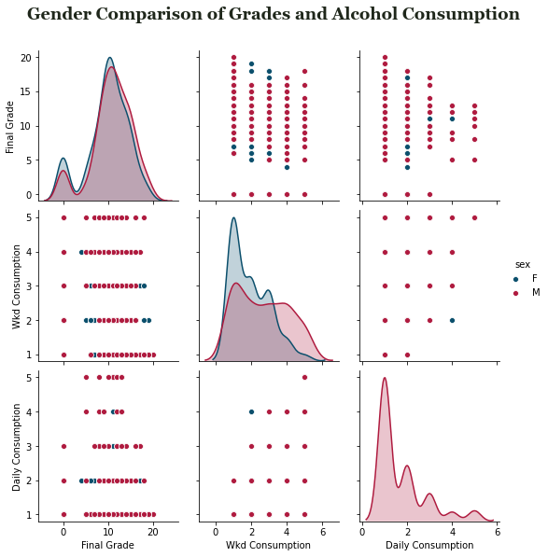
Comparison of consumption and grades based on gender

Slide 9
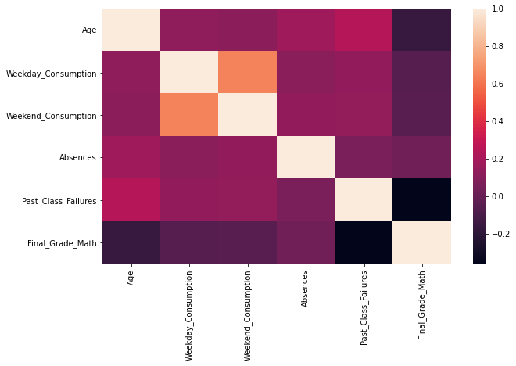
Correlation

Slide 10
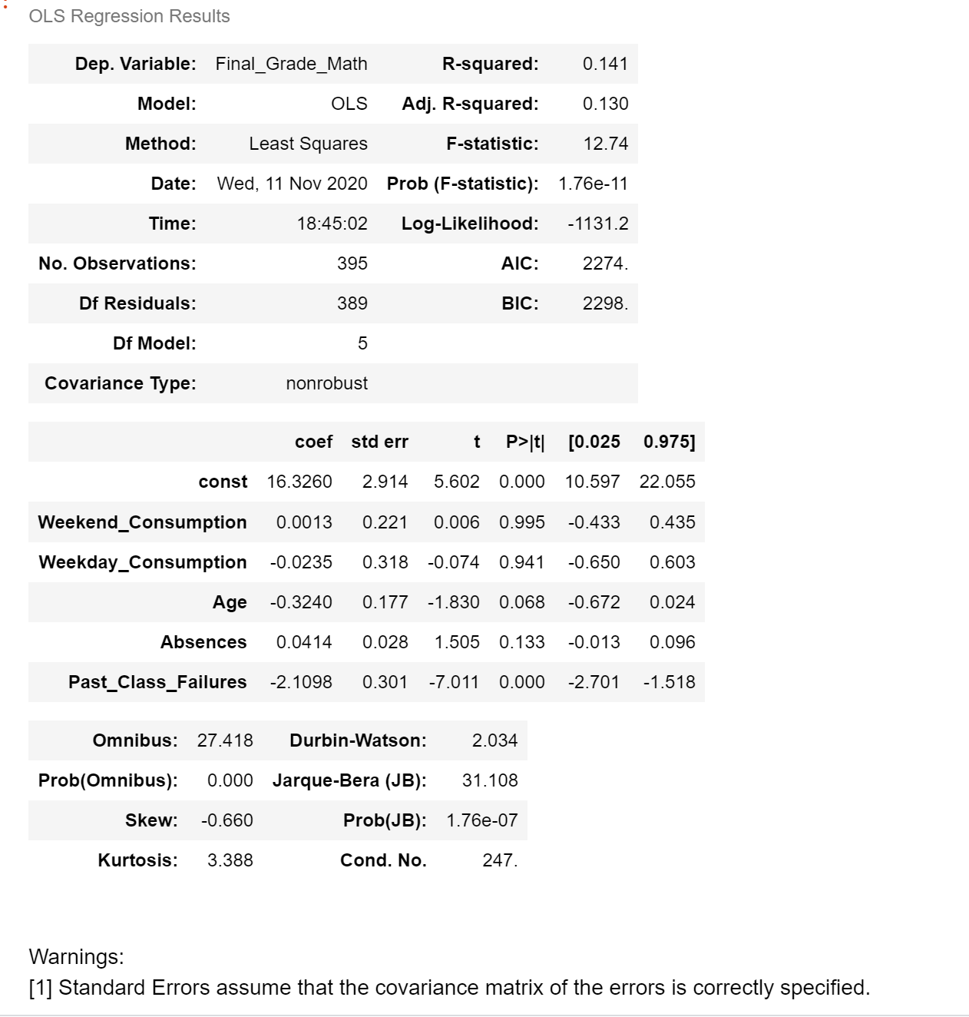
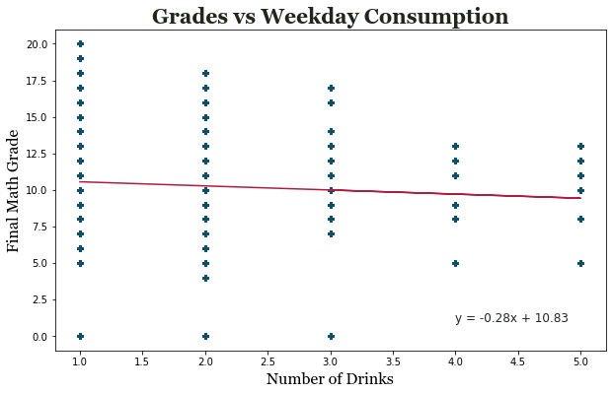
Relationship between Grades and alcohol

Slide 11
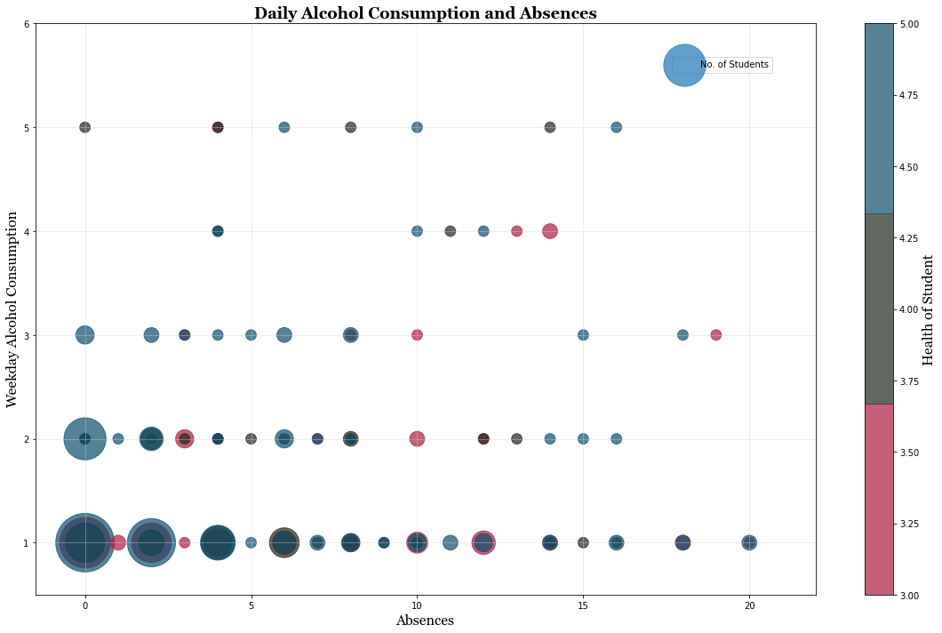
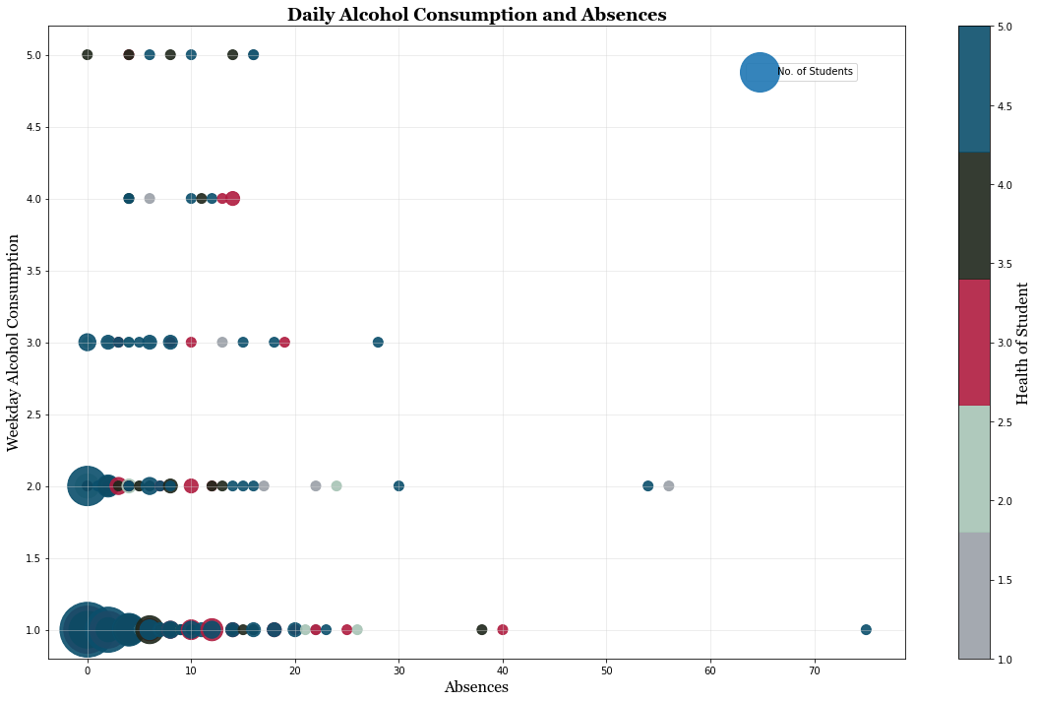
Alcohol consumption and absences

Slide 12
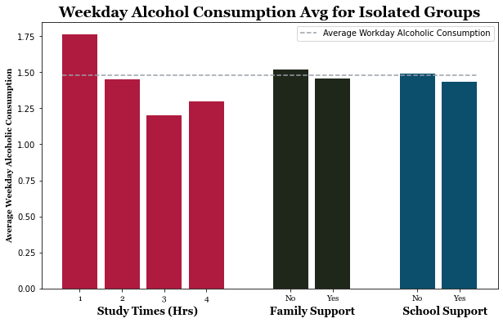
Alcohol consumption for different student demographics

Slide 13
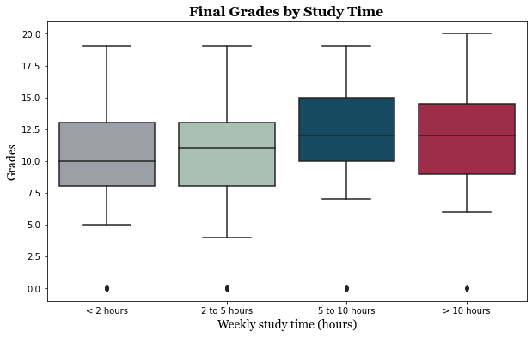
Grades based on study time

Slide 14
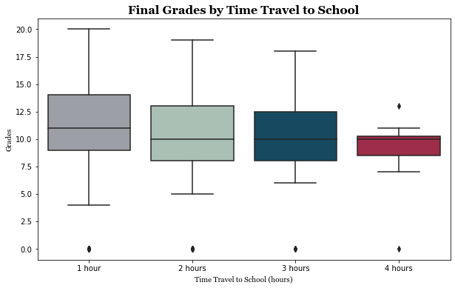
Grades by travel time

Slide 15
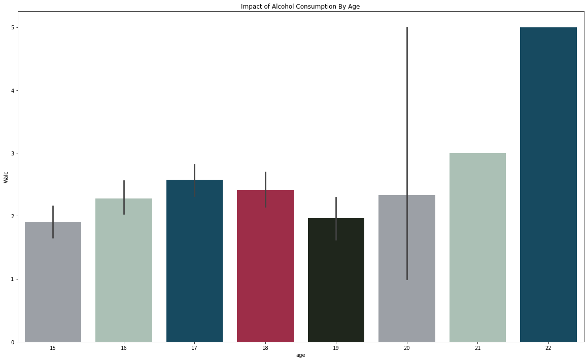
Alcohol consumption by age

Slide 16
Our Conclusion
We have found that on average if a student’s mother or father has more education that the student’s grade was slightly better
On average, males had higher alcohol consumption, on weekdays and weekends, than females
The amount a student drinks during the week is found to not be a good predictive measure for what their final math grade is
There is no correlation between math grades and alcohol consumption
The more the student drinks has no effect on absences
On average, students who studied 5+ hours had the best math grades
The less the students have to travel, the better their grades are
The older the students were, the higher their alcohol consumption was on the weekend
Notes:
Abby

Slide 17
Possible Limitations or Biases
Only samples for 2 schools in Europe
Only took grades from math class
The students may of down played the amount they drank when being asked to answer the survey
Students could of elected to not take the survey
Did not include students who did not drink
Notes:
Hoa

Slide 18
Future work recommendations
Look at grades for classes beyond Math
Look at other external factors that could be influencing these results
Compare similar data for students in the USA or another country
Notes:
Hoa

Slide 19
References
Dataset taken from Kaggle
https://www.kaggle.com/uciml/student-alcohol-consumption

